Slide 1
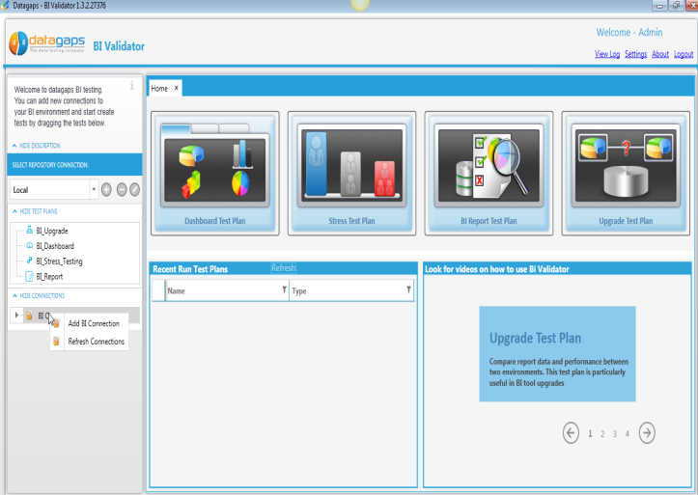
datagaps
The data testing company
BI Validator:
Testing Automation Solution for Oracle Business Intelligence Projects
Notes:
1

Slide 2
Lesson Plan
Background

Slide 3
The Problem
11.1.x
Monthly Releases
Monthly Releases
11.x.
Monthly Releases
ETL/Db Upgrades
Regression/Load Testing Oracle Business Intelligence Applications is challenging and requires enormous amount of manual effort and money. Even then, delivering high quality analytics to business users and customers can be a daunting task with the number of changes in each release.

Slide 4
Introducing BI Validator
BI Validator is the only solution in the market that is patented and completely automates regression, performance, upgrade and stress testing of Oracle Business Intelligence Applications.
This was specifically designed by Oracle Alumni for Oracle customers to cut down costs, to minimize testing time and to deliver accurate insights to business users

Slide 5
BI Validator Select Features
Complete Automation
Dashboard Testing
Prevent regression by identifying differences between dashboards (pre and post change) with ease
Prevent regression with proper change management
Catalog Testing
Stress Testing
Upgrade with confidence
Upgrade Testing
Understand performance and regression issues in OBIEE Reports
Report Testing
Know how an OBI system behaves as users access the dashboards and reports concurrently
Multi Environment Testing
Quickly compare multiple environments and ensure that the dashboards/reports are as expected
Scheduling
Execute test plans over time to identify regression issues early on in the development cycles

Slide 6
Test Plans for Various Roles Based on our experience
 | DEV | QA | BA
Dashboard Test Plan | Y | Y | Y
Report Test Plan | Y | Y | Y
Upgrade Test Plan | Y | Y | Y
Catalog | Y | Y
Stress | Y | Y
Physical Query | Y | Y
Adhoc Test Plan | Y | Y | Y

Slide 7
Lesson Plan
Architecture

Slide 8
BI Validator Architecture
BI Validator User
3
1
Web Service/GoURL
BI Validator
Test Creation/
Execution
OBI User Credentials
Authentication
2
OBIEE
BI Validator Repository
Presentation
Sever
4
6
BI
Server
LDAP
5
RPD
Authorization
Oracle Business Intelligence Platform
Warehouse
Notes:
Authentication of a BI Validator User is independent of OBI. The credentials will be matched against the repository
Once a user logs in, he can navigate the OBI Catalog ( Web Service)
All tests hit OBI instance via web services/ GoUrl
BI Validator pushes all requests to BI Server.
BI Server verifies the authentication against enterprise LDAP server, executes the physical queries and returns the PDF/Data responses
The responses are captured in BI Validator and used in testing

Slide 9
Lesson Plan
Key Components

Slide 10
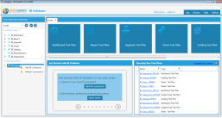
Key Components
BI Validator Client
Windows based app
(UI to create tests)
Repository
Oracle/Firebird Database
(to store tests/data)
BI Validator Server
Windows based
(to execute scheduled tests)
Usage tracking
Oracle Business Intelligence Platform
Notes:
Narendar: Hi Adi. We use
Go URL : Executing reports and dashboards in Dashboard TP, Report TP, Upgrade TP & Stress TP.
Physical Query TP, Report TP, Subject Area TP
Usage Tracking connection to database for getting the physical query for Physical Query TP and Subject Area TP
hat about authentication?
Narendar: Authentication we check Go URL and Webservices

Slide 11
Lesson Plan
User Interface

Slide 12
Login Screen

Slide 13
Home

Slide 14
Navigation to Scheduler

Slide 15
Scheduler Screen

Slide 16
Admin Credentials

Slide 17
SMTP Settings

Slide 18
Groups - Visibility

Slide 19
License Information

Slide 20
Lesson Plan
Interaction Design with OBI

Slide 21
Authentication Design
Parameters
Dashboard URL
http://23.21.171.107:8080/analytics/saw.dll
OBI Username
OBI Password
Usage Tracking DB (optional)
BI Validator Client
Windows based app
GoURL & Web Services
Oracle Business Intelligence Platform

Slide 22
Metadata Retrieval and Testing Catalog, Subject Area, Dashboard and Report Metadata
Catalog Tree in BI Connection
Subject Area Test Plan
Physical Query Test Plan
Report Test Plan
Catalog Test Plan
BI Validator Client
Windows based app
Web Services
Oracle Business Intelligence Platform

Slide 23
Test Case Execution
Dashboard Test Plan
Report Test Plan
Upgrade Test Plan
Stress Test Plan
BI Validator Client
Windows based app
Go URL
Oracle Business Intelligence Platform

Slide 24
Usage Tracking for Physical Query Testing
Physical Query Test Plan
Subject Area Test Plan
1
BI Validator Client
Windows based app
Specify Conn Details
Usage tracking
2
Retrieve Physical Query
Web Services
Oracle Business Intelligence Platform

Slide 25
Lesson Plan
Interaction Design

Slide 26
Adding a Repository

Slide 28
Adding a Connection

Slide 33
Prereqs
Firefox Browser
Selenium IDE Plugin for Firefox - You can download and install it from http://www.seleniumhq.org/projects/ide/
BI Validator 2.5 or later

Slide 34
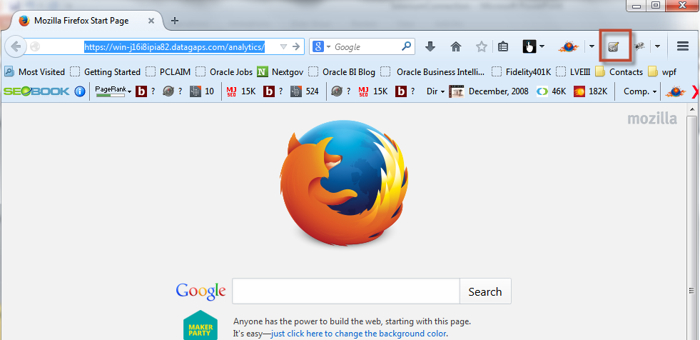
Open Selenium IDE
Click on the ‘Se’ icon to open Selenium IDE

Slide 35
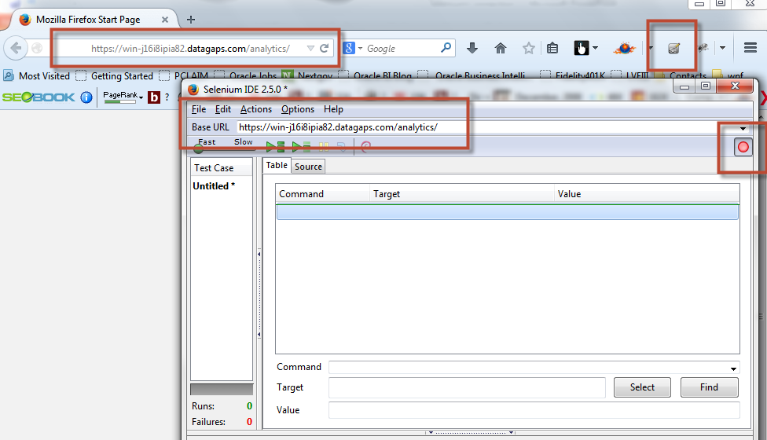
Enter you OBIEE login URL
Start the recording
Enter you OBIEE login URL
Recording is on by default

Slide 36
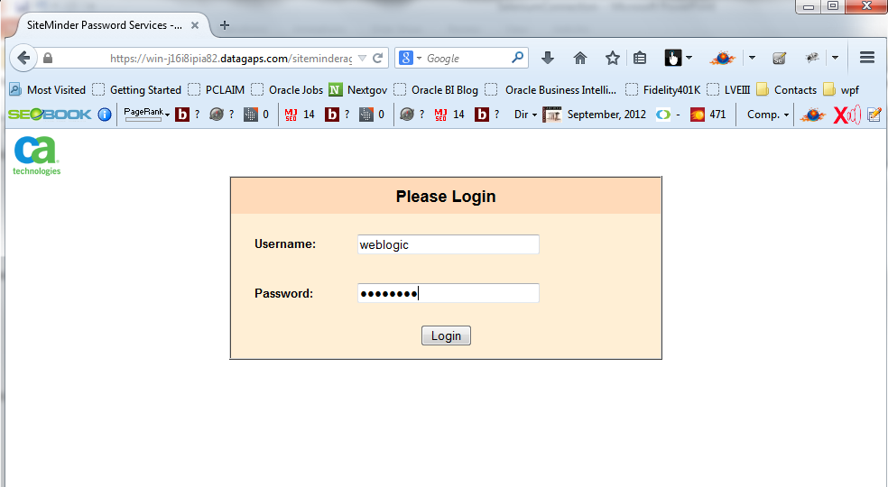
Login to you OBIEE environment
If you have active directory, there may not be any login screen. This screen may not appear in that case which is ok.

Slide 37
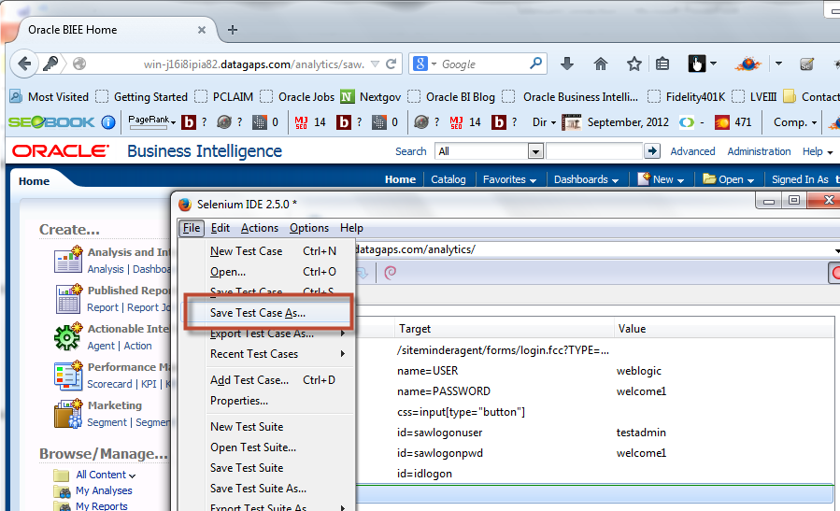
Save the recorded Test Case
Save Test Case into a folder
Recorded test steps

Slide 38
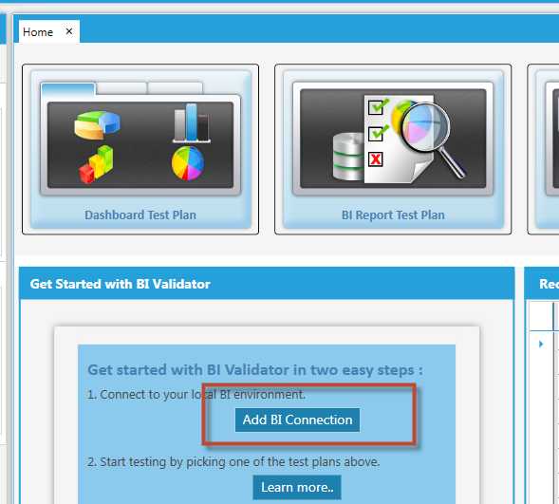
Add a new BI Connection
Click on ‘Add BI Connection in BI Validator

Slide 39
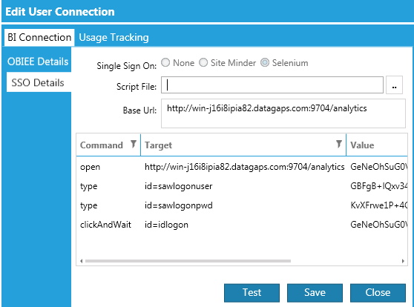
Browse and select the saved file
1. Select the ‘Selenium’ option
2. Enter Base URL which is typically your single signon URL
3. Browse and select the test case file saved in previous steps
4. Recorded test steps should show up.

Slide 40
Test and Save the BI Connection
Save the connection once the test is successful
Test the connection. This will automatically popup the firefox browser and login to your BI env.

Slide 41
Test Plan Creation

Slide 42
Dashboard Test Plan

Slide 43
Use Cases
To be able to detect regression in OBI Dashboards

Slide 44
Login

Slide 45
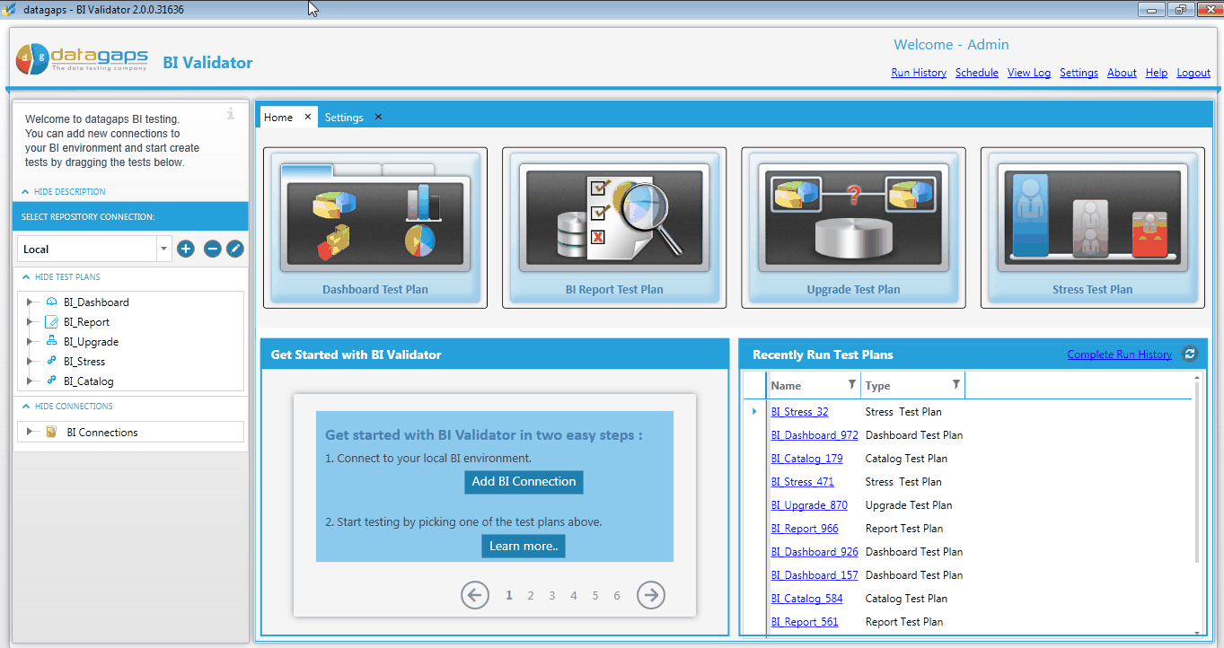
Home Page
Select Dashboard Test Plan by clicking on this image

Slide 46
Choose Connection
Verify Name, Connection Details

Slide 47
Choose Dashbaords
Drag Dashboards and drop them into the right side pane

Slide 48
Save Dashboards
Bi Validator pings the OBI server and saves the dashboards (benchmark)

Slide 49
Make Changes
Now, you can make your back end changes, in place upgrades etc

Slide 50
Open The test Plan
Open BI Validator and navigate to the test plan

Slide 51
Run
Run the test plan

Slide 52
View Differences
Differences will be displayed in an intuitive manner

Slide 53
Report Test Plan

Slide 54
Objective
As a QA Engineer or a Business Analyst, I want to ensure that my reports have not regressed after back end changes

Slide 55
Select Report Test Plan

Slide 56
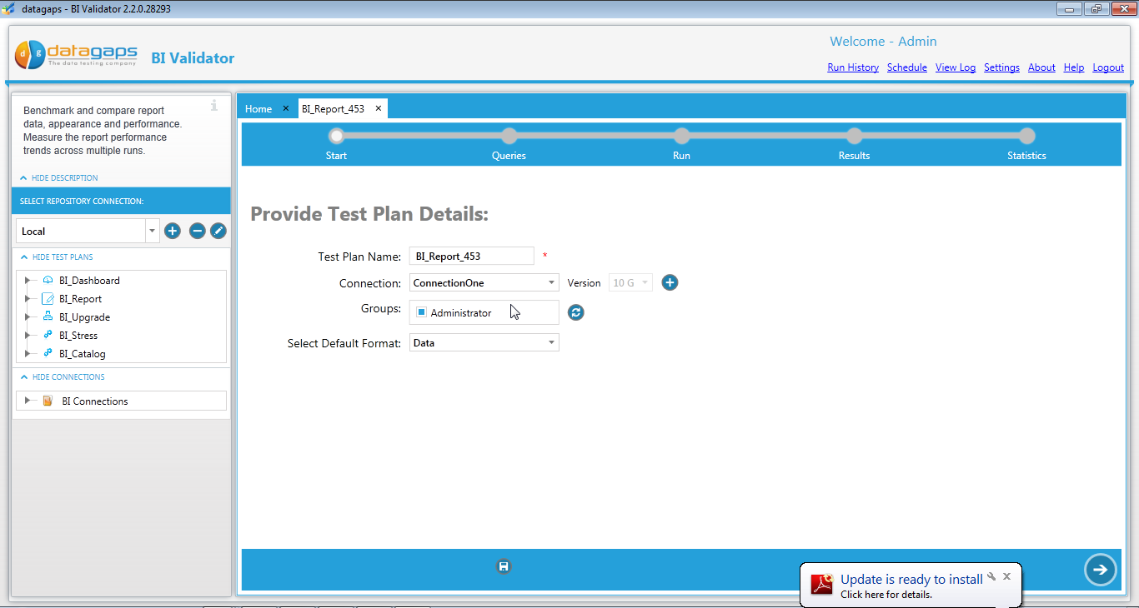
Pick Connection
Pick “Data” or “PDF” option (for report comparison

Slide 57
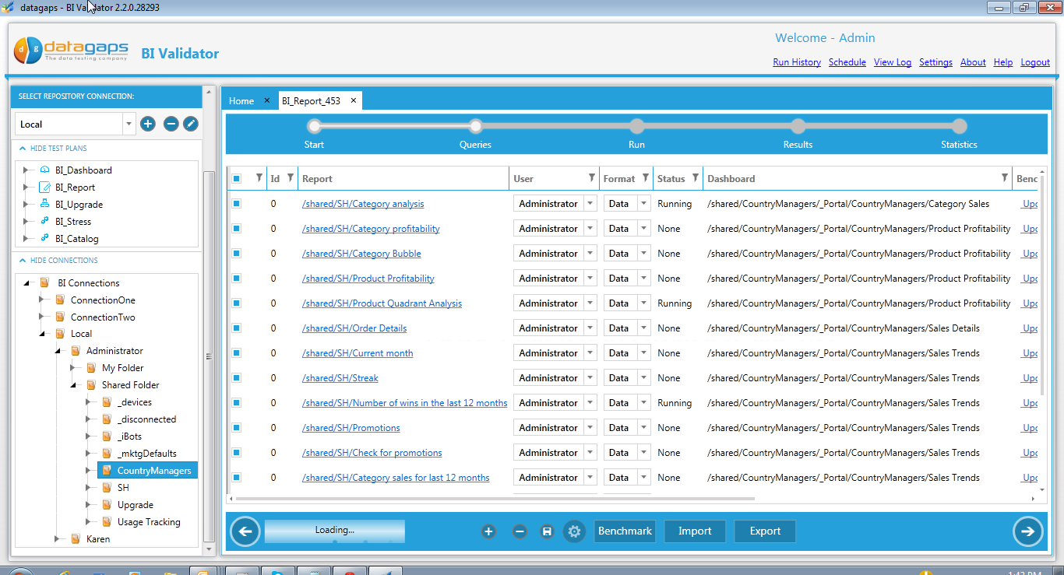
Drag and Drop Reports for benchmarking
Example: Before making any changes to Metadata, ETL etc, take benchmark (reference sets) of the reports

Slide 58
Make changes to your OBI Platform (outside of the tool)

Slide 59
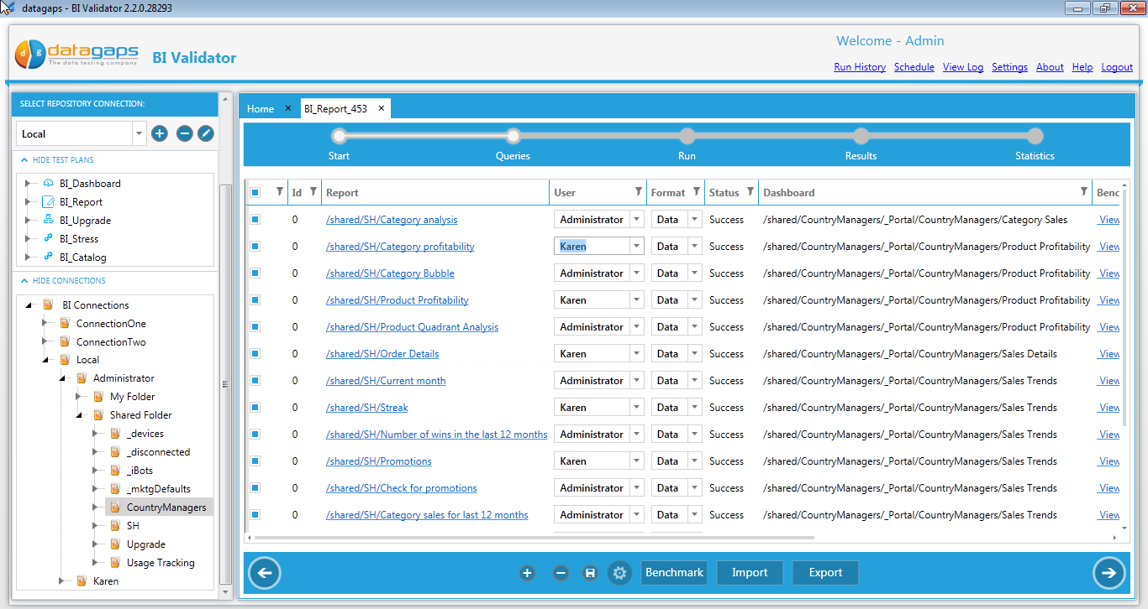
Log back into BI Validator, open the test plan and navigate to the next screen

Slide 60
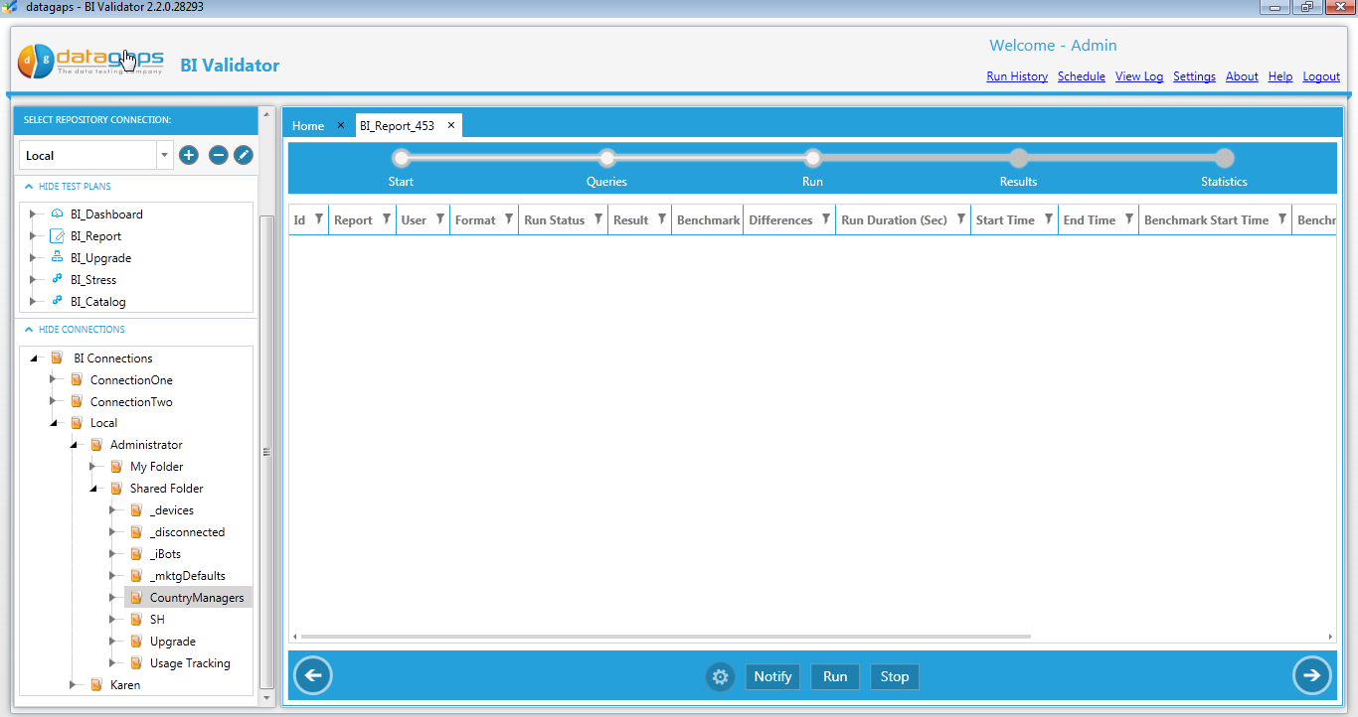
Click on Run

Slide 61
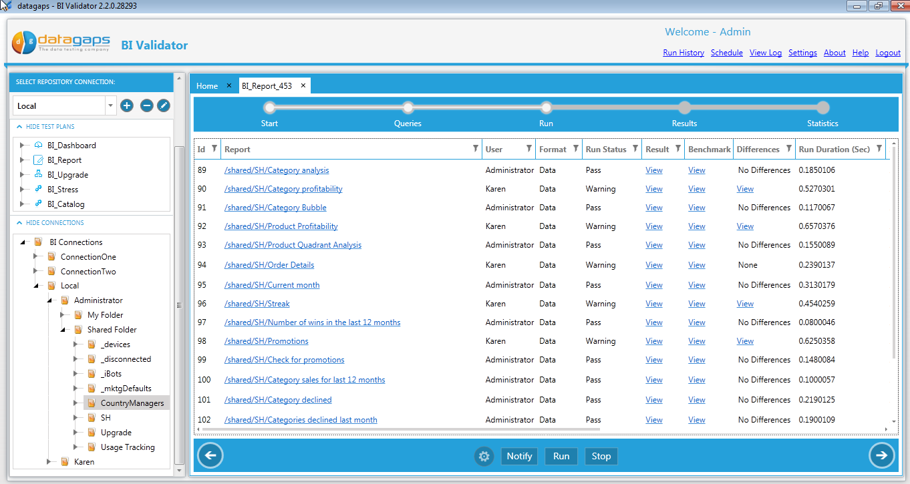
Results will be displayed in the screen. If there are any differences, the test will be marked as “Failure. Click on the “View link.

Slide 62
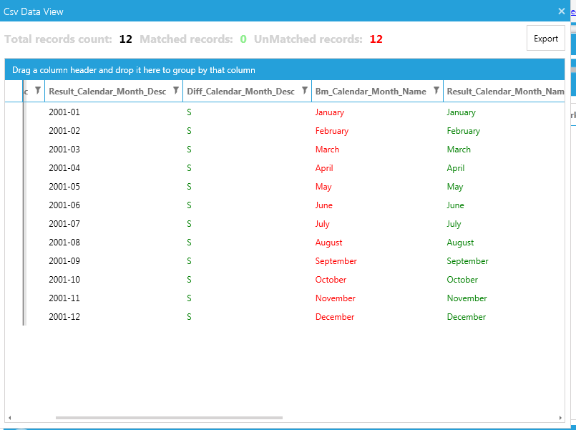
Differences between the benchmarked report and the run time report will be highlighted.

Slide 63
CatalogTest Plan

Slide 64
Objective
To ensure that the OBI Catalog has only the expected changes when moving content from one environment to an other environment

Slide 65
Login

Slide 66
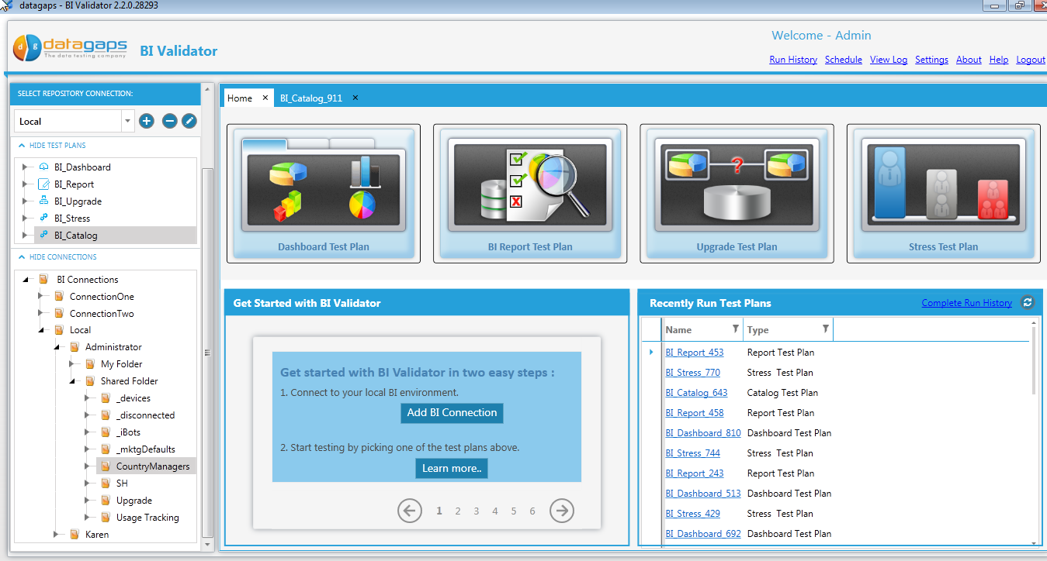
Select Catalog Test Plan

Slide 67
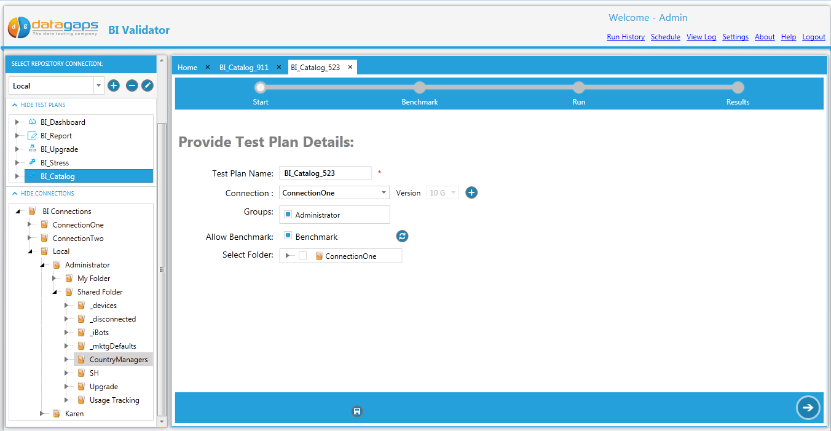
Select the BI Connection of interest

Slide 68
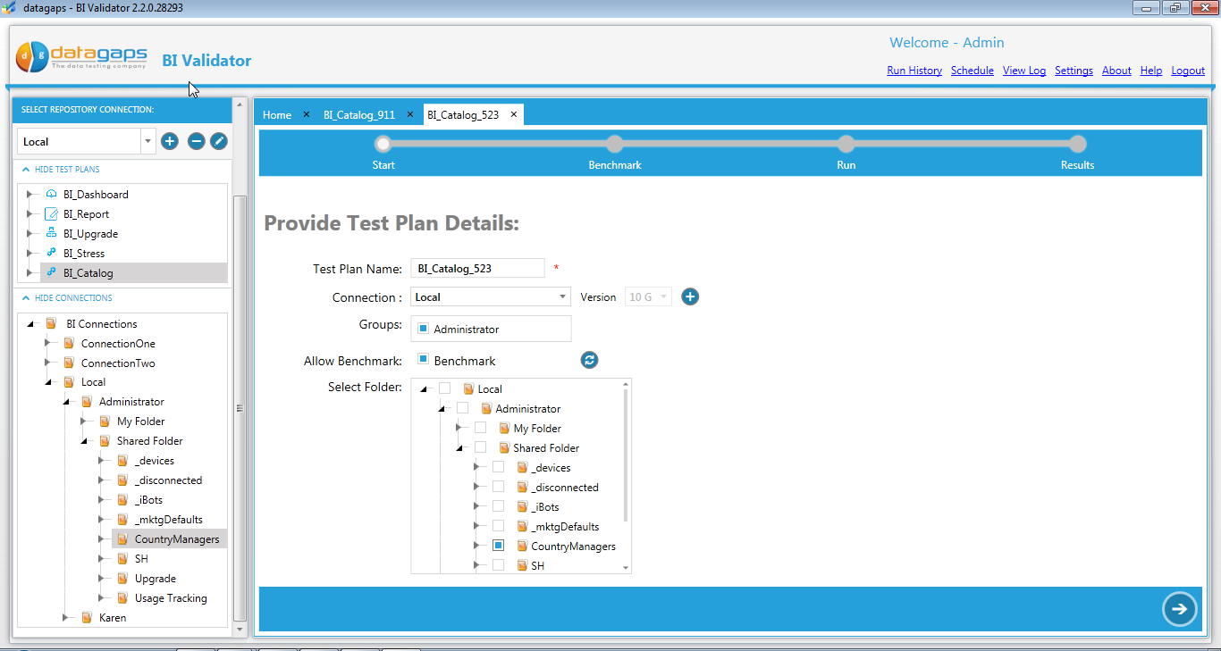
Select Catalog Folder you want to test

Slide 69
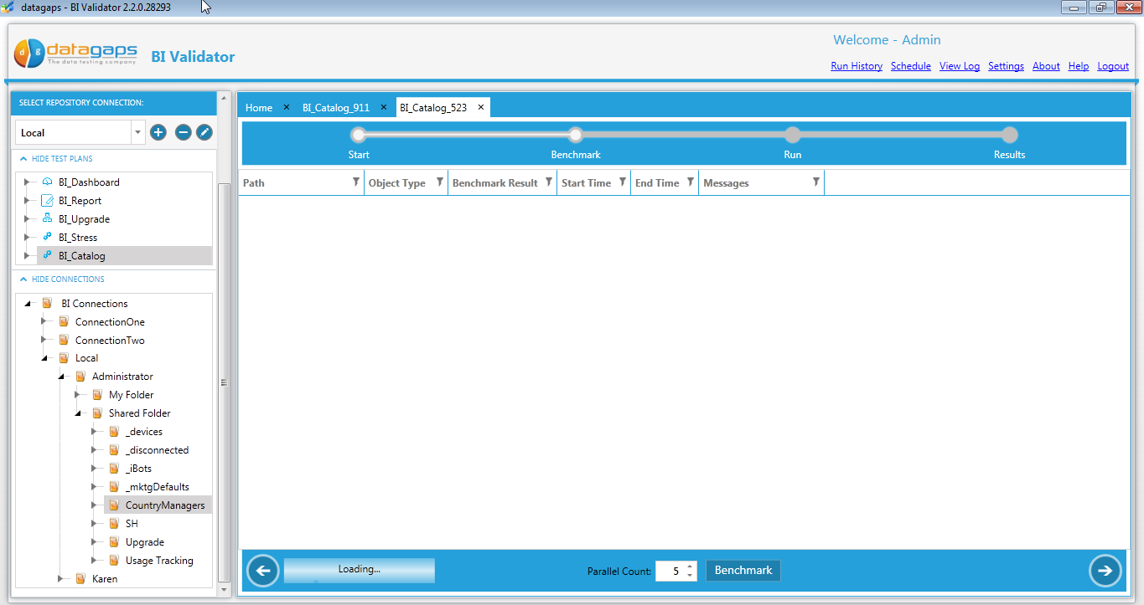
Wait till you see the selected content here

Slide 70
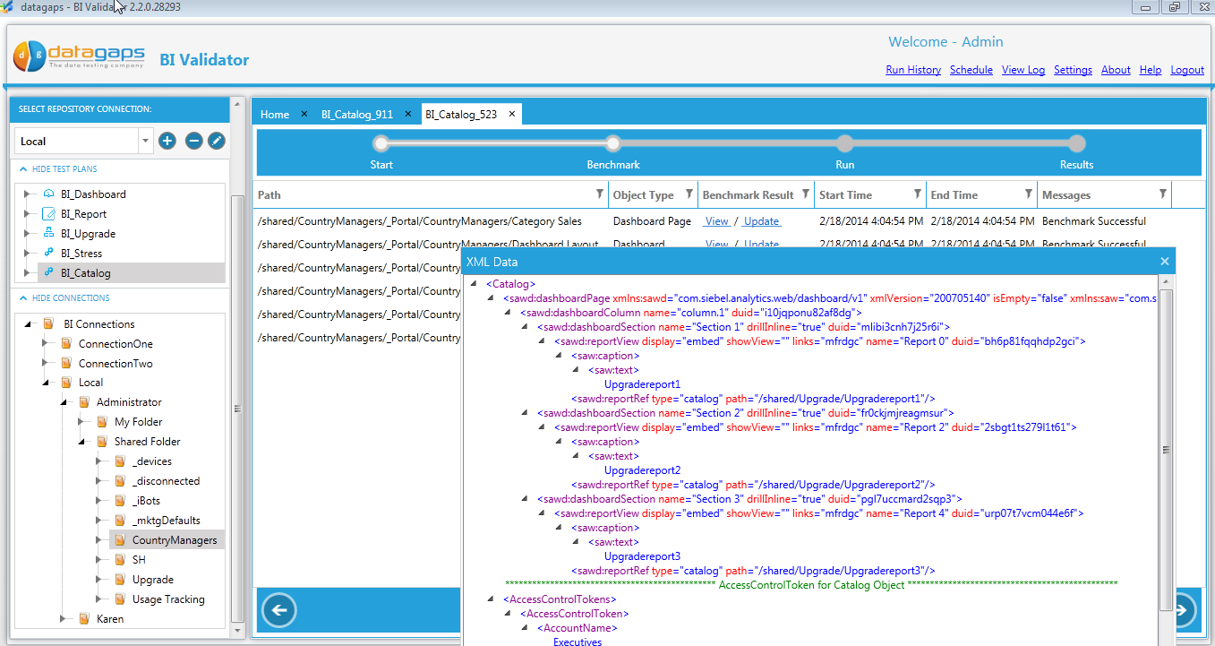
Click “View” to see the content XML

Slide 71
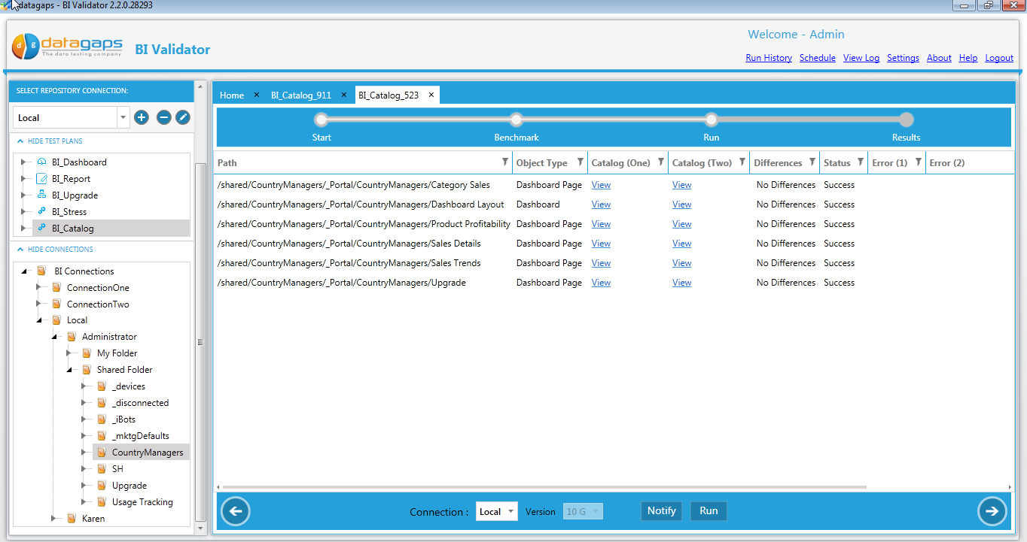
Select Connection to compare against
Click on run. Results will be shown above. If there are differences, you will be able to click on a “View” link and see the differences

Slide 72
Adding Usage Tracking Table

Slide 73
Part 2
Stress Testing
Adhoc Test Plan
Upgrade Test Plan

Slide 74
More Resources
http://www.datagaps.com
http://youtube.com/datagaps
http://www.twitter.com/datagaps

