Slide 1
Creating Web Service Test Plan with ETL Validator

Slide 2
SOAP Services:
Cloud applications such as Oracle CRMOD, Salesforce, Workday etc. can be tested using SOAP Services
ETL Validator supports SOAP Services as a data source.
Web Service Test Plan extracts data from SOAP Services.

Slide 3
Pre-Requisites:
SOAP Service

Slide 4
Create Web Service Test Plan
Select the option ‘Web Service Test Plan’
Select Web Service Test Plan

Slide 5
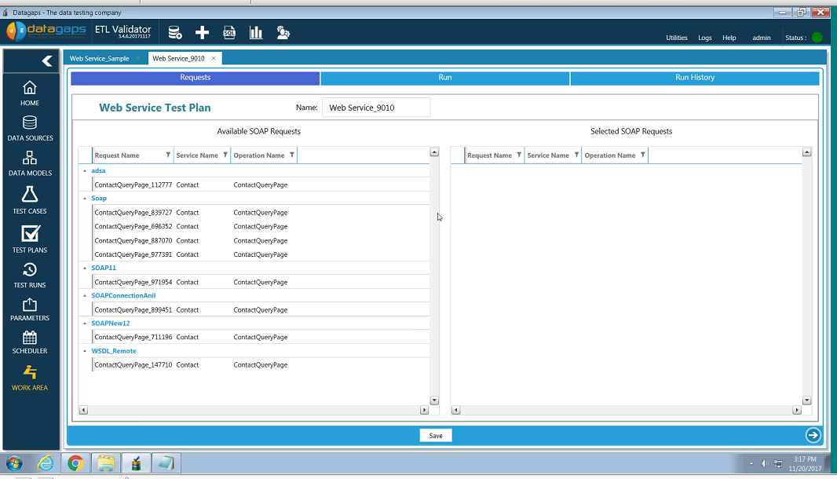
Create Web Service Test Plan
List of existing SOAP Web Service connections are displayed in left pane
Select the Web Service to be tested.
Select the SOAP Service

Slide 6
Create Web Service Test Plan
Drag the selected SOAP request to the right pane
Drag the SOAP Service item

Slide 7
Create Web Service Test Plan
The chosen SOAP request is displayed on the right pane.
Click on the Arrow to go to Next screen
Click on Arrow for Next screen

Slide 8
Execute SOAP Request
Click on ‘Run’ button to execute the SOAP request.
Click on Run

Slide 9
Result of SOAP Request
Results are displayed as shown in the right pane after execution
Result of the SOAP request

Slide 10
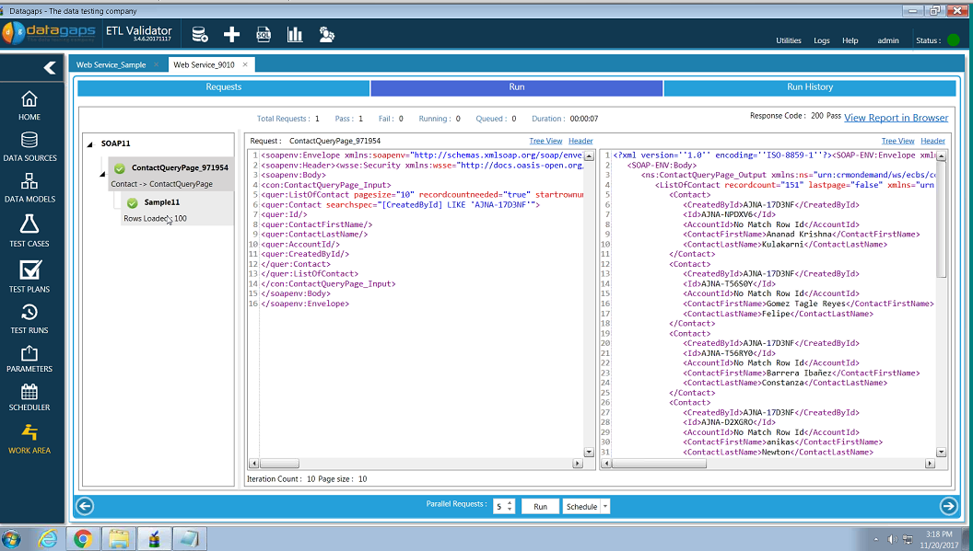
Result of SOAP Request
Results are displayed as shown in the right pane after execution
Note that the number of records loaded is 100.
Number of records is based on Page Size and Max Page Count setting done earlier in the process.
Please refer to next slide to see where it was done.
This is the number of records
Result of the SOAP request

Slide 11
Create SOAP Request
For reference:
This is the slide from previous process to show how to set the record count
Start Row Number
Page Size
Max Page Count
Set:
Start Row Number
Page Size
Max Page Count

Slide 12
What’s next?
Create Query Compare Test Case
To compare the data extracted by Web Service Test Plan with another database.
Create Component Test Case
To compare the data extracted by Web Service Test Plan with another source/target such as flat files, tables etc.

