Slide 1
Creating SOAP Connection with ETL Validator

Slide 2
SOAP Services:
Cloud applications such as Oracle CRMOD, Salesforce, Workday etc. can be tested using SOAP Services
ETL Validator supports SOAP Services as a data source.

Slide 3
Pre-Requisites:
WSDL file on your local machine
Existing Web Service Connection
Note: To learn how to create web service connection, please refer to –
https://www.slideshare.net/ProductMarketingdata/web-service-connection-using-ws-security-82978268
https://www.slideshare.net/ProductMarketingdata/web-service-connection-using-login-operation-82977835

Slide 4
Create SOAP Request
2. Modify the encoding
3. Select multipage response
After saving authentication details, select an operation from the left side tree.
This creates new request.
Details show up on the screen as shown.
Modify the encoding type to "ISO-8859-1“
Select the multi page response checkbox to set the record count
Start Row Number
Page Size
Max Page Count
Click on Execute button
Set
Start Row Number
Page Size
Max Page Count
5.Click on Execute
1.Drag and drop an operation to the right

Slide 5
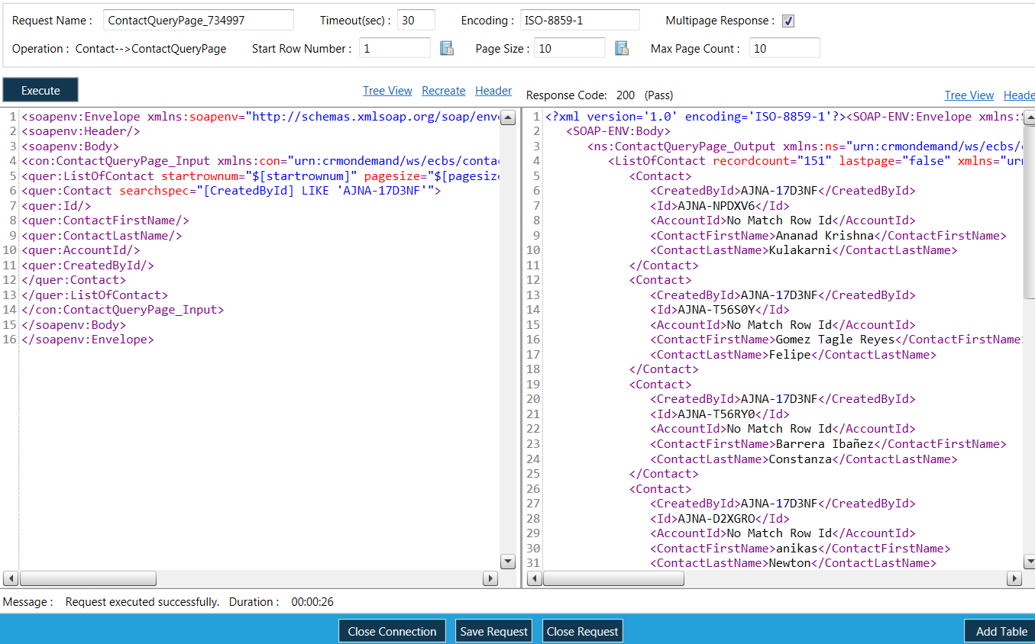
Create SOAP Request
When Execute button is clicked, response shows up in right pane as shown.
Now to create a table, click on "Add Table" button.
6.Click on Add Table

Slide 6
Create Table
New screen comes up.
Name the new table as shown.
7.Name the table

Slide 7
Create Table
Expand the Envelope and subsequent items.
Drag the tree node (contact) from left side pane of envelope tree to create columns.
Click to expand the Envelope
Drag Contact to the right pane

Slide 8
Create Table
Fields in the Contact entity show up as columns alongwith the metadata.
Now click on the Save button to create table.
Columns of Contact entity
Click on Save

Slide 9
Create Table
A successful message pops up - table is created and saved successfully.
Click on ‘Close’ to move to next screen.
Note: For "Login Operation" Authentication type, drag the "getSessionEnvironment" operation to the right to create request & table in the same way.
Click on OK
Click on Close

Slide 10
Create Table
Give name to create new table in the top left corner text box as shown.
This is the request
This is the table

Slide 11
SOAP Request created, what’s next?
Create Web Service Test Plan
To extract data from the SOAP Connection.
Create Query Compare Test Case
To compare the data extracted by Web Service Test Plan with another database.
Create Component Test Case
To compare the data extracted by Web Service Test Plan with another source/target such as flat files, tables etc.

