Slide 1
BI Validator ALM Integration

Slide 2
High Level Steps
Create an ALM Connection
BI Validator uses ALM REST API to integrate with ALM. No ALM Server changes are needed.
Map an existing ALM Test Case (from a Test Set) to BI Validator Test Plan
When a Test Plan is executed in BI Validator, it automatically creates a Test Run Instance in ALM and posts the results to ALM

Slide 3
Setting up the ALM Connection

Slide 4
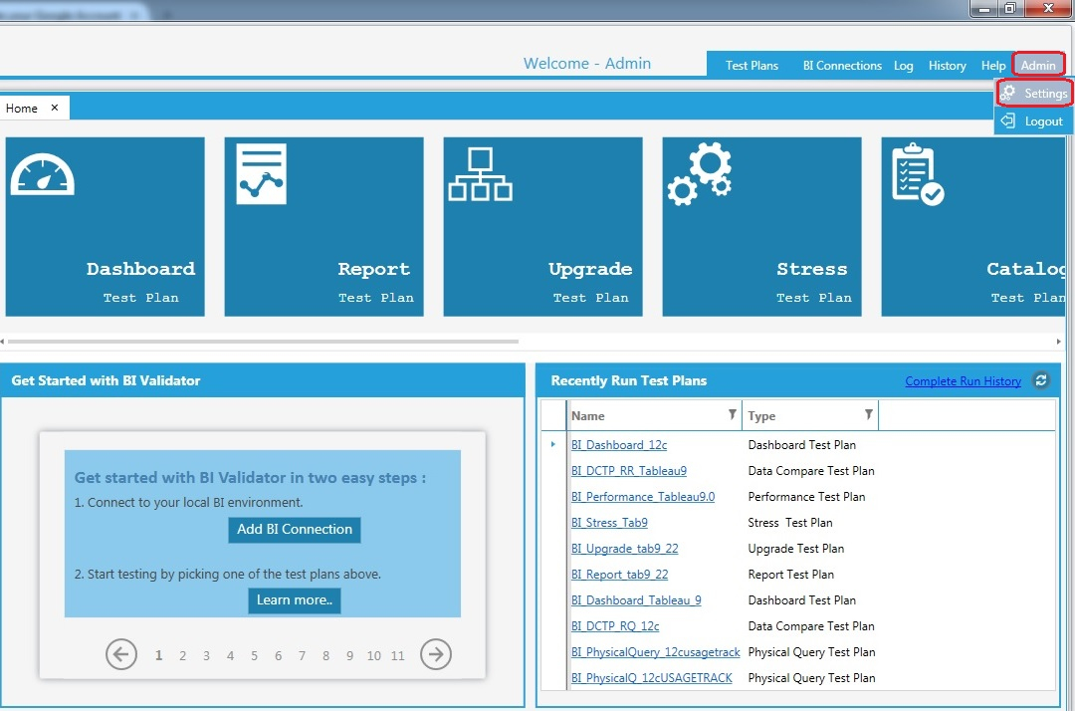
Click on settings to open the Settings window

Slide 5
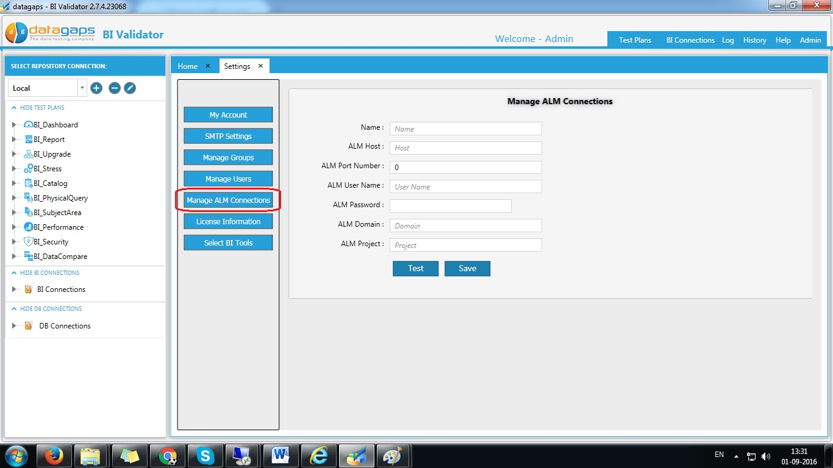
Click on “Manage ALM Connections“ button to add a new ALM Connection

Slide 6
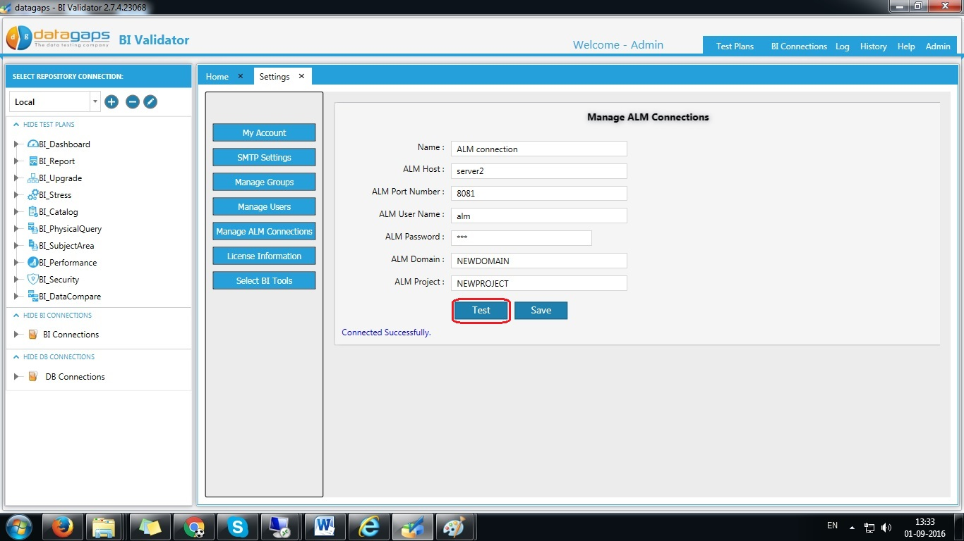
Enter the new ALM connection details and click on test button to verify the details

Slide 7
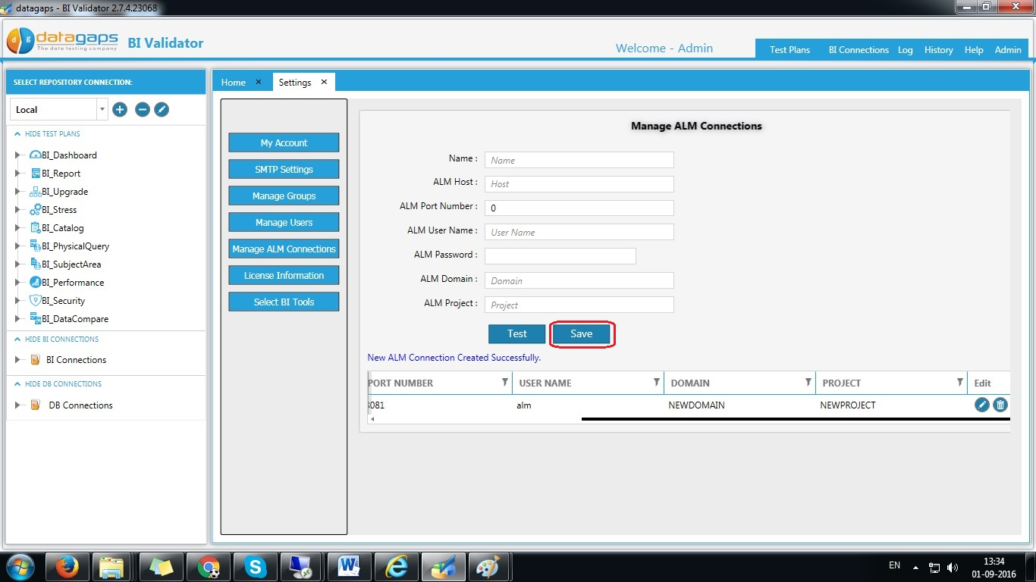
Click on save button , creates the new connection and details are shown in the below grid
Connection details

Slide 8
Map BI Validator Test Plan to ALM Test Case

Slide 9
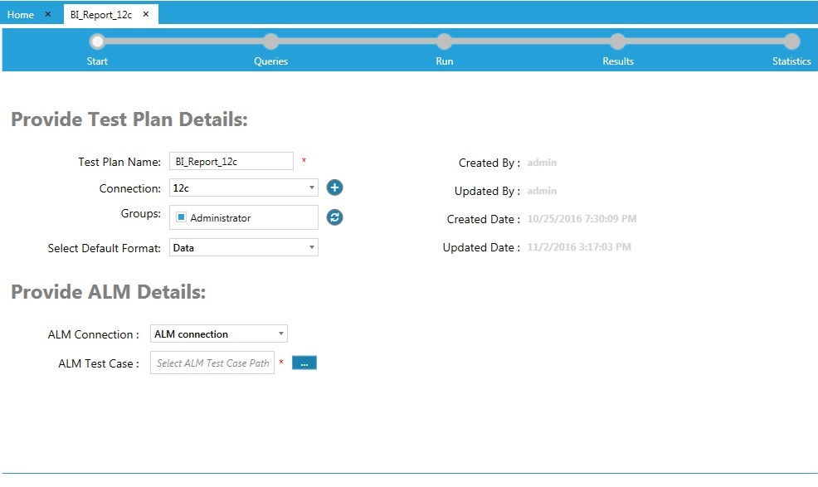
BI Report Test Plan
Click here to select the ALM Test case, it opens a popup

Slide 10
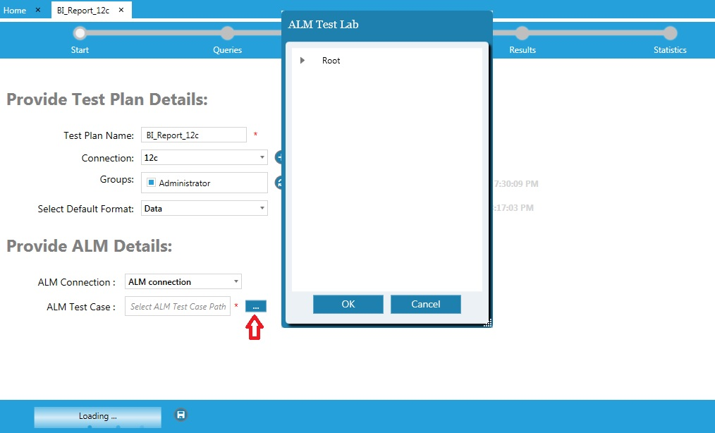

Slide 11
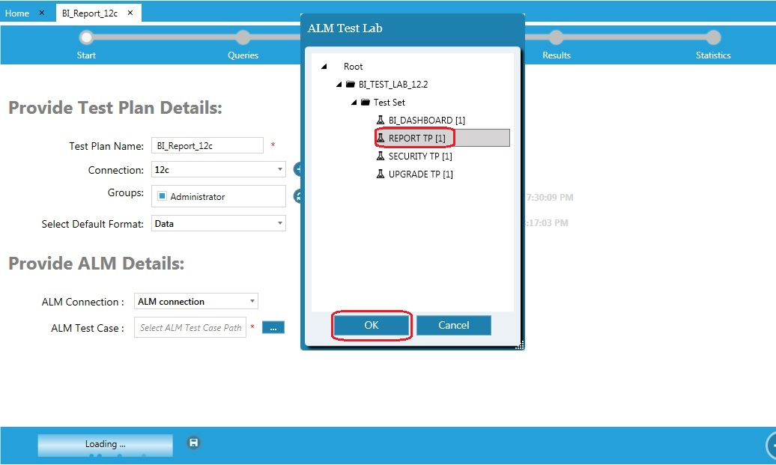
Select the ALM Test Case in the popup and click on OK button.
Then run the Test Plan

Slide 12
Execute Test Plans from BI Validator & see results in ALM

Slide 13
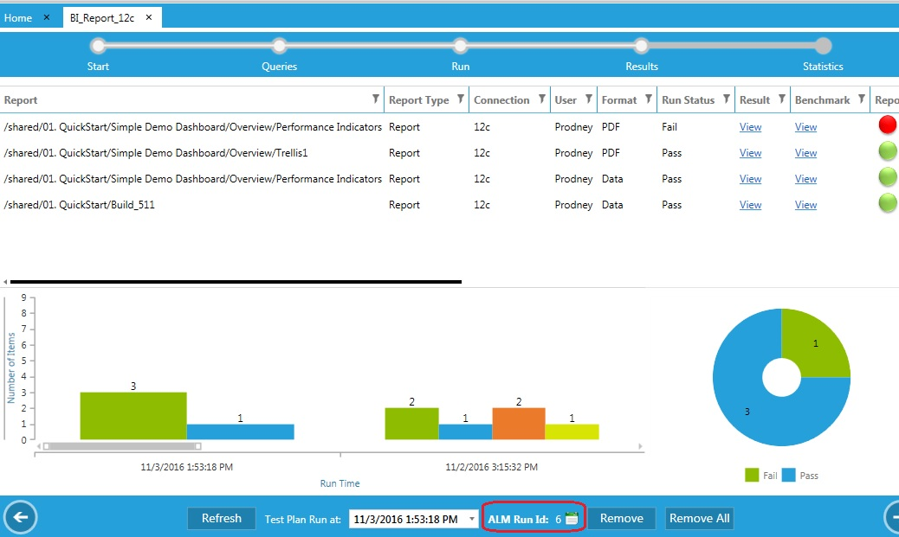
After running the Test Plan, the results are posted to ALM and ALM Run ID is shown here.

Slide 14
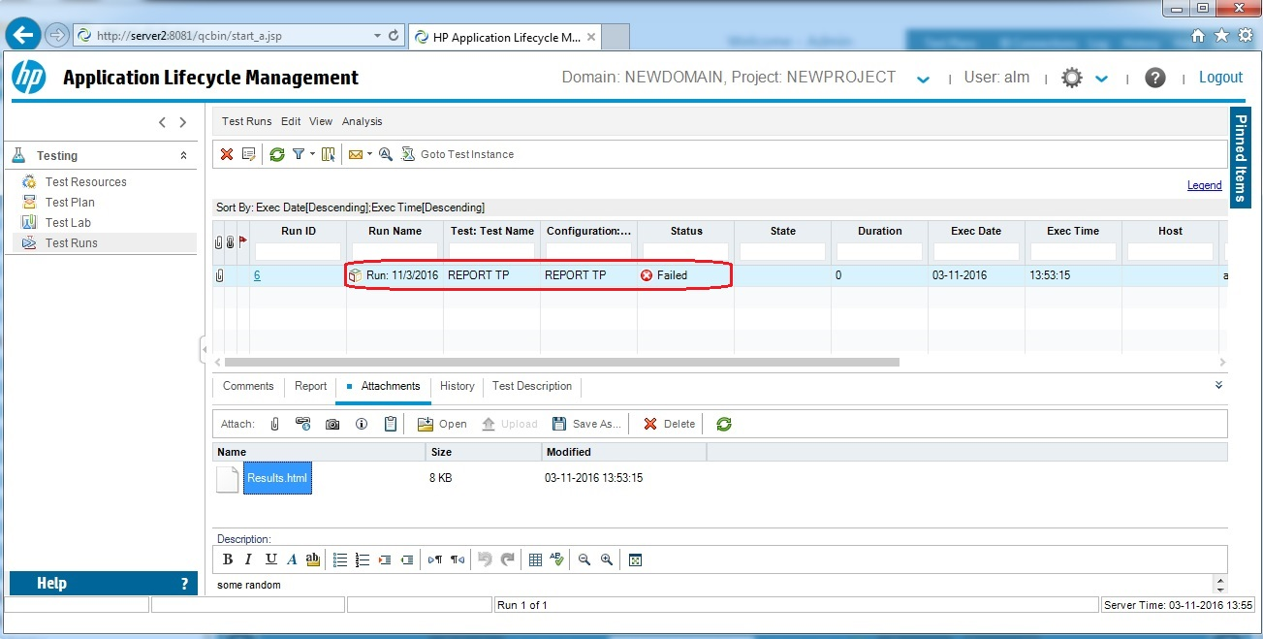
Based on the ALM ID , user can check the details in the ALM here.
This “Results.html” can be opened to view the results of the Test Plan

Slide 15
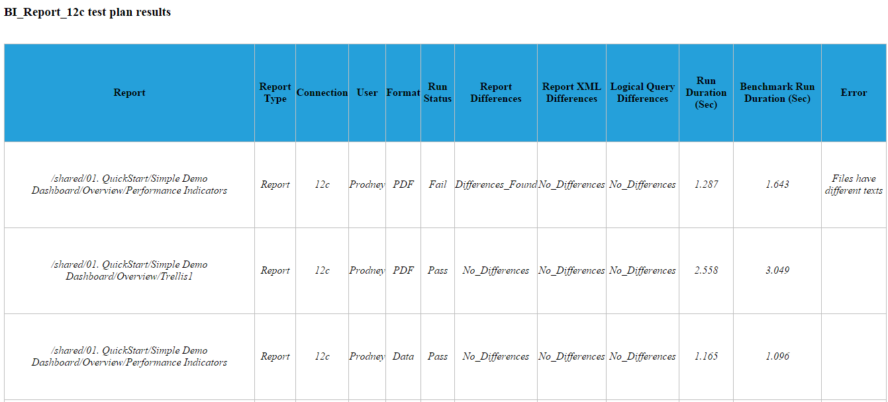
Results.html screen shot

